Slide 1
Machine Learning
Jason Tseng
Information Engineering, KSU

Slide 2
Classification Algorithms – Support Vector Machine Algorithm
Support vector machines (SVMs) are flexible supervised machine learning algorithms which are linear models used both for classification and regression.
It can solve linear and non-linear problems and work well for many practical problems
In 1960s, SVMs were first introduced but later they got refined in 1990. SVMs have their unique way of implementation as compared to other machine learning algorithms.
Lately, they are extremely popular because of their ability to handle multiple continuous and categorical variables.

Slide 3
Support Vector Machine Algorithm- Theory
The idea of SVM is simple: The algorithm creates a line or a hyperplane in multidimensional space which separates the data into classes.
The hyperplane will be generated in an iterative manner by SVM so that the error can be minimized.
The goal of SVM is to divide the datasets into classes to find a maximum marginal hyperplane (MMH).

Slide 4
Support Vector Machine Algorithm- Problem
Suppose you have a dataset as shown below and you need to classify the red rectangles from the blue ellipses(let’s say positives from the negatives).
So your task is to find an ideal line that separates this dataset in two classes (say red and blue).
There isn’t a unique line that does the job. In fact, we have an infinite lines that can separate these two classes. So how does SVM find the ideal one???

Slide 5
Support Vector Machine Algorithm- Problem
Suppose we have two candidates here, the green colored line and the yellow colored line. Which line according to you best separates the data?
If you selected the yellow line then congratulations, because that’s the line we are looking for. It’s visually quite intuitive in this case that the yellow line classifies better. But, we need something concrete to fix our line.
The green line in the image above is quite close to the red class. Though it classifies the current datasets it is not a generalized line and in machine learning our goal is to get a more generalized separator.

Slide 6
SVM’s way to find the best line
The main goal of SVM is to divide the datasets into classes to find a maximum marginal hyperplane (MMH) in the following two steps −
Generates hyperplanes iteratively that segregates the classes in best way.
Choose the hyperplane that separates the classes correctly.
Support vector: find the points closest to the line from both the classes. These points are called support vectors.
Hyperplane: a decision plane or space which is divided between a set of objects having different classes.
Margin: compute the distance between the line and the support vectors. This distance is called the margin.
Our goal is to maximize the margin. The hyperplane for which the margin is maximum is the optimal hyperplane.

Slide 7
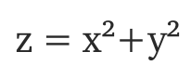
Case study
Let’s consider a bit complex dataset, which is not linearly separable.
We cannot draw a straight line that can classify this data. But, this data can be converted to linearly separable data in higher dimension.
Lets add one more dimension and call it z-axis. Let the co-ordinates on z-axis be governed by the constraint,
z co-ordinate is the square of distance of the point from origin. Let’s plot the data on z-axis.

Slide 8
Case study
Let the purple line separating the data in higher dimension be z=k, where k is a constant. Since, z=x²+y² we get x² + y² = k; which is an equation of a circle.
We can project this linear separator in higher dimension back in original dimensions using this transformation.
finding the correct transformation for any given dataset isn’t that easy. Thankfully, we can use kernels in sklearn’s SVM implementation to do this job.
A hyperplane in an n-dimensional Euclidean space is a flat with n-1 dimensional subset of that space that divides the space into two disconnected parts.
decision boundary

Slide 9
SVM Kernels
SVM algorithm is implemented with kernel that transforms an input data space into the required form.
A technique called the kernel trick in which kernel takes a low dimensional input space and transforms it into a higher dimensional space. i.e, kernel converts non-separable problems into separable problems by adding more dimensions to it.

Slide 10
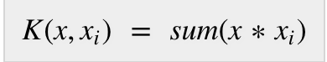
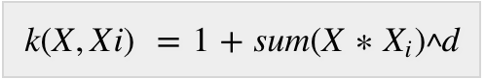
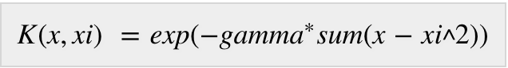
Types of kernels used by SVM
Linear Kernels: A dot product between any two observations/vectors (x, x_{i} )
Polynomial Kernel: more generalized form of linear kernel and distinguish curved or nonlinear input space (d is the degree of polynomial
Radial Basis Function (RBF) Kernel: mostly used in SVM classification, maps input space in indefinite dimensional space (gamma ranges from 0 to 1, default value of gamma is 0.1)

Slide 11
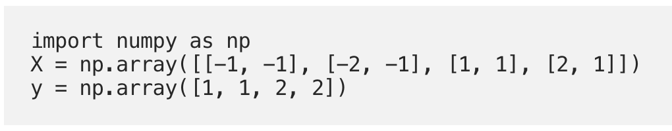
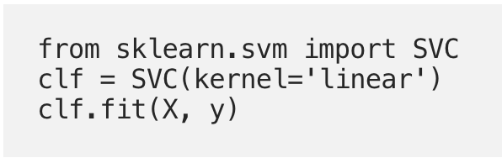
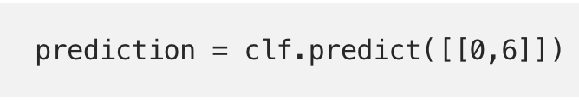
A simple python implementation
Data set: training points in X and the classes they belong to in Y
Train the SVM model using a linear kernel
Predict the class of new dataset:[0, 6]

Slide 12
TUNING PARAMETERS for SVM
Some important parameters for SVM:
Regularization parameter C: It controls the trade off between smooth decision boundary and classifying training points correctly. A large value of c means you will get more training points correctly.
Eg. There are a number of decision boundaries that we can draw for this dataset. Consider a straight (green colored) decision boundary which is quite simple but it comes at the cost of a few points being misclassified. These misclassified points are called outliers.

Slide 13
TUNING PARAMETERS for SVM
We can also make something that is considerably more wiggly(sky blue colored decision boundary) but where we get potentially all of the training points correct.
The trade off having something that is very intricate, very complicated like this is that chances are it is not going to generalize quite as well to our test set.
Something that is simple, more straight maybe actually the better choice if you look at the accuracy. Large value of c means you will get more intricate decision curves trying to fit in all the points.
Figuring out how much you want to have a smooth decision boundary vs one that gets things correct is part of artistry of machine learning. So try different values of c for your dataset to get the perfectly balanced curve and avoid over fitting.

Slide 14
TUNING PARAMETERS for SVM
Important parameters for SVM:
Gamma: define how far the influence of a single training example reaches. If it has a low value it means that every point has a far reach and conversely high value of gamma means that every point has close reach.
If gamma has a very high value, then the decision boundary is just going to be dependent upon the points that are very close to the line which effectively results in ignoring some of the points that are very far from the decision boundary.
This is because the closer points get more weight and it results in a wiggly curve as shown in previous graph. On the other hand, if the gamma value is low even that the far away points get considerable weight and we get a more linear curve.

